Slide 1
V3D1
WEEK 3A
Physics engine

Slide 2
Physics Engines
A physics engine is a library
Gives physical properties to an object, like
  mass
  friction
  hardness
  etc
The object will move, according to those properties

Slide 3
What a physics engine can do
Collision detection
Gravity
Forces
Sliding
Deform objects
…

Slide 4
Some physical notions
Mass (m)
  Every object has a mass, measured in (kilo)gram
  Mass is not weight (weight depends on gravity)
Time (t)
  Measured in (milli)seconds
  All physics calculations are done once in every frame
Position (p)
  Every object has a certain position
  Which point is used to define position?
    Center of gravity or
    Center of the physics shape

Slide 5
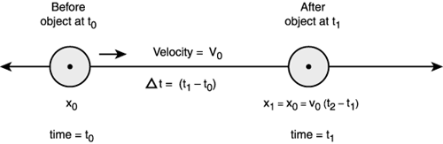
Some physical notions
Velocity (v)
  Change in position
  with respect to time
    Velocity is the derivative of position
    Velocity is a vector
  Measured in m/sec or km/hr

Slide 6
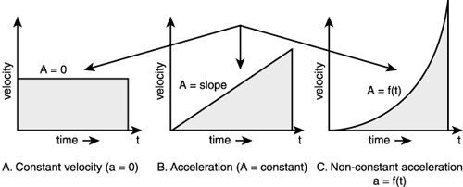
Some physical notions
Acceleration (a)
  Change in velocity with respect to time
    Acceleration is the derivative of velocity
    Acceleration is a vector
    Without acceleration, an object will be static, or move with constant velocity

Slide 7
Some physical notions
Force (F)
  This is what makes objects move, by accelerating them
  F=m*a or a=F/m
    The higher the force, the faster the object will accelerate
    The higher the mass, the slower the object will accelerate
  Measured in Newton (N) (= kg*m/sec²)
  Force is a vector
  When an object is moving, and there is no force or friction, it will keep moving in the same direction, with the same velocity
  Multiple forces can work on an object, these are added

Slide 8
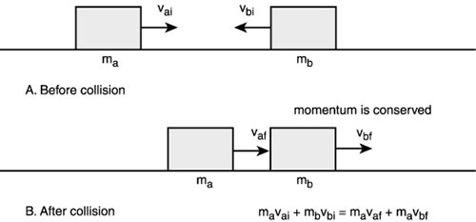
Some physical notions
Momentum (P)
  P=m*v
  Momentum is a vector
  Actually, force is the
  derivative of momentum
    It takes force to change the momentum of an object
  Preservation of momentum:
    When 2 (or more) perfectly elastic objects collide, their
    total momentum will not change
    When an object explodes, all pieces together will have the same momentum
      the COG of all pieces will continue following the same path

Slide 9
Some physical notions
Torque (τ)
  A force always works on a certain point of the object
    Usually the center of gravity (COG)
    If not the COG (and if the object has rotational freedom), then the object will rotate (torque)
      if it has a fixed axis of rotation (like a hinge on a door), it will rotate around that axis
      otherwise it will rotate around the COG
  τ = r x F (x is cross product; Dutch: uitproduct)
    r = vector from COG to point of force
    Result is again a vector
      magnitude: r*F*sin(α)(α is angle between r and F)
      direction: perpendicular to r and F

Slide 10
Some physical notions
Gravity
  Force that attracts objects to each other
  Depends on the mass of these objects
  General formula:
    F_{g} = G*m₁*m₂/r²
      G is the gravitational constant (6.67428x10⁻¹¹ N*(m/kg)²)
      r is the distance between the centers of gravity
  For one object, close to the earth’ surface:
    F_{g} = m*g
      g = G*(mass of earth)/(radius of earth)²
      g is the gravitational acceleration = 9.80665 m/s²
      F_{g} points downwards, acts on COG

Slide 11
Some physical notions
Friction
  Consumes ‘useless’ energy, slows down objects
  Usually has 2 forms:
    A certain force F_{fst} is needed before an object starts moving
    A certain force F_{fkin} is needed to keep a moving object moving with the same speed
  For an object on a horizontal plane, we have:
    F_{fst} = m*g*µ_{s}
      µ_{s} is static friction constant, depends on object and plane materials
    F_{fkin} = m*g*µ_{k}
      µ_{k} is kinetic friction constant
    Sometimes one single friction constant is used: (µ_{s}+µ_{k})/2

Slide 12
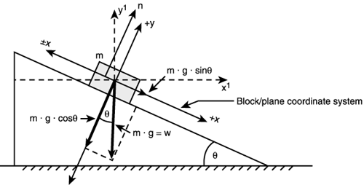
Some physical notions
Friction
  For an object on an inclined plane:
    There is a critical angle for the plane, at which the object will start to slide on its own:
      arctan(µ_{s})
    When it is sliding, the acceleration is:
      g*(sin(ϴ)-µ_{k}*cos(ϴ))

Slide 13
Possible shape properties
Bounciness
  determines how elastic the collisions will be between this material and another
  with higher bounciness, the object will bounce further when it collides
  must be between 0 and 1
Density
  mass per unit of volume
  combined with the volume determines the mass
  must be >= 0

Slide 14
Possible shape properties
Friction
  simple friction constant
  must be between 0 and 1
Hardness
  determines how far objects can interpenetrate
  must be between 0 and 1

Slide 15
Collision detection
One of the things a physics engine will do is collision detection
Continuously, all pairs of object will be checked to see if they collide
  Usually both collision entry and exit is detected
This takes a lot of time, because:
  objects can have complicated shapes
  there can be many objects
    If there are n objects, then n*(n-1)/2 pairs of objects have to be checked

Slide 16
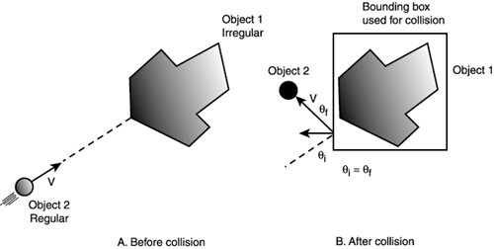
Collision detection
To simplify the collision detection calculations:
  Objects are given a
  second (simpler) shape:
  collision area or collision
  geometry, which is used
  for physics calculation
    box, sphere, cylinder, …
  Only relevant objects are included in calculations
  Objects can be combined into collision groups
    only objects in the same collision group can collide
    less pairs to be checked

Slide 17
Collision detection
Collision geometry can sometimes be a problem
  Consider a table with 4 legs
  If the collision geometry is the bounding box, it will be impossible to move something between the legs
To solve that, collision detection can be done in 2 phases
  broad phase
    use collision geometry to see which objects could collide
  narrow phase
    use the actual geometry to check if these objects really collide

Slide 18
Vizard specifics
For any object, we can add a collision geometry:
  collideBox, collideSphere, collideCapsule
    Create smallest possible box, sphere or cylinder around object
    Takes arguments friction, density, hardness, bounce
  collideMesh
    Uses the exact shape of the object for collisions
    Forces do not work on in this case, so also no gravity
  collidePlane
    By default horizontal plane y=0
    Can be changed into any plane ax+by+cz=d:
    collidePlane(a,b,c,d)

